Slide 1
CHM 101 2020-2021
Learning Objectives:
Important applications of equilibra like
pH
Solubility
Solubility of Ionic Solids
Dr Oladoyinbo F. O.

Slide 2
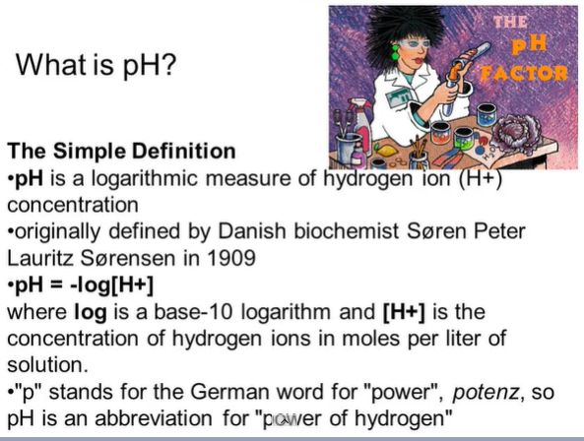

Slide 3
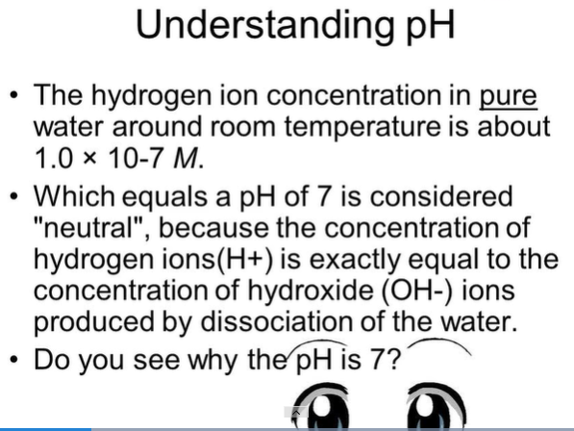

Slide 4
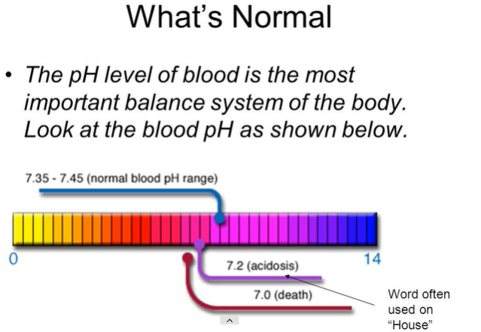

Slide 5
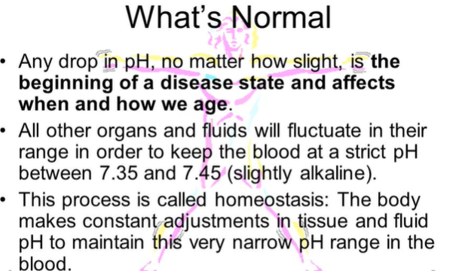

Slide 6
PH
&
its Applications

Slide 7
COMMON PH VALUES AROUND US
pH of cheese is between 4.8−6.4. pH of bananas is between 4.5−5.2. pH of grapes is between 3.5−4.5. pH of lime juice is between 2.0−2.4.

Slide 8
IMPORTANCE OF PH
Our body works within the pH range of 7.0 to 7.8.
Living organisms can survive only in a narrow range of pH change.
When pH of rain-water is less than 5.6, it is called acid rain.
When acid rain flows into the rivers, it lowers the pH of the river water.
The survival of aquatic life in such rivers becomes difficult.

Slide 9
PH IN DIGESTIVE SYSTEM -
The pH in the human digestive tract varies greatly.
The pH of saliva is usually between 6.5 - 7.5. The fundic or upper portion of the stomach has a pH between 4.0 - 6.5,
lower portion of the stomach secrete hydrochloric acid (HCI) and pepsin until it reaches a pH between 1.5 - 4.0

Slide 10
PH METER
A pH Meter is a scientific instrument that measures the hydrogen-ion concentration (or pH) in a solution, indicating its acidity or alkalinity.
The pH meter measures the difference in electrical potential between a pH electrode and a reference electrode.

Slide 11
PH IN GROWING CROPS - DEFINITION
pH is a scale that chemists use to measure acidity. Values below 7 are considered acidic, values above 7 are alkaline ( the opposite of acidic) and 7 is neutral.
Most plants can tolerate a wide pH range in solution culture, but they cannot tolerate a wide range of acidity in the soil.

Slide 12

RANGE OF PH SCALE
The range of pH scale is from 0 to 14. The pH value from 0 to 7 indicates the acidic nature of solution whereas from 7 to 14 indicates the basic nature of solution. The intermediate value that is 7 indicates neutral nature of solution such as pure water. Ammonia or Sodium Hydroxide show the pH value in the range 7-14, which reflects their basic nature. On the contrary, acidic substances like vinegar, stomach acid, battery acid, coke etc show pH range from 0-7 that shows their acidic nature.

Slide 13
EFFECT OF PH ON PLANTS AND ANIMALS
High levels of either acidity or alkalinity can be harmful to plants and animals.
Effect on Plants: Most of the plants do best when soil’s pH is in the neutral range i.e. 6 to 7. Acidic soil can prevent certain nutrients from being absorbed by plants that are best absorbed in alkaline soil. In very alkaline soil, certain important micro-nutrients such as zinc and copper become chemically unavailable to plants.
Effect on Animals: Effect of pH is most observed for the animals that stay in water. Acidic water robs fish and other aquatic species of sodium in the blood and oxygen in the tissues. Additionally, it affects the functioning of fish gills. Acidic water also poisons fish eggs, as they will not hatch if water pH is too low. In addition to the direct effects on fish, acid water also destroys ecosystems by killing organisms lower on the food chain.

Slide 14
EFFECT OF PH ON TOOTH DECAY
The saliva in a healthy mouth has a pH of 7.1.
Certain foods increase the acidity of the mouth and reduce the pH level. Saliva helps neutralize the acid, but the pH of saliva can become more acidic after eating acidic foods. It can take between a few minutes to a few hours for the pH of the mouth to neutralize.
In that time, the lower pH of the mouth creates an optimal environment for bad bacteria, which eventually causes tooth decay.

Slide 15
PH OF SOIL IN BACKYARD
Soil pH is dictated by type of parent material from which soil is formed, rainfall, organic matter content among others.
Soil in the backyard would mean it consists of kitchen garden growing grass, vegetables, trees etc., and it would have been supplied with some kind of organic amendments, fertilizers etc., over a period of time.
In such a scenario pH of acidic soils would improve and move towards neutral and pH of alkali soils would also move towards neutral.

Slide 16
PH OF SALTS
Salt can be made of either a weak acid and strong base, strong acid and weak base, strong acid and strong base, or a weak acid and weak base. 1. Salts that are formed from strong bases and strong acids will give a pH of 7 in their solution. 2. Salts that are formed from strong bases and weak acids give a pH greater than 7 in their solution. 3. Salts that are formed from weak bases and strong acids give a pH of less than 7 in their solution.

Slide 17
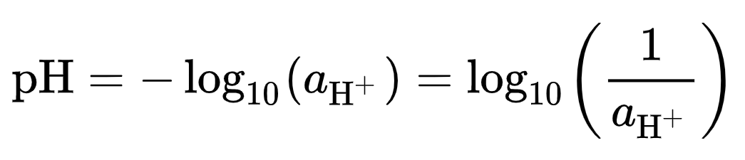
pH in Chemistry
pH is defined as the decimal logarithm of the reciprocal of the hydrogen ion activity, a_{H+} in a solution.
pH= - log [H⁺]

Slide 18
For example,
For a solution with a hydrogen ion activity of 5×10⁻⁶ (at that level, this is essentially the number of moles of hydrogen ions per litre of solution)
There is 1/(5×10⁻⁶) = 2×10⁵,
Thus such a solution has a
pH of log₁₀(2×10⁵) = 5.3

Slide 19
pH depends on temperature
For instance at 0 °C the pH of pure water is about 7.47.
At 25 °C it is 7.00,
and at 100 °C it is 6.14.

Slide 20
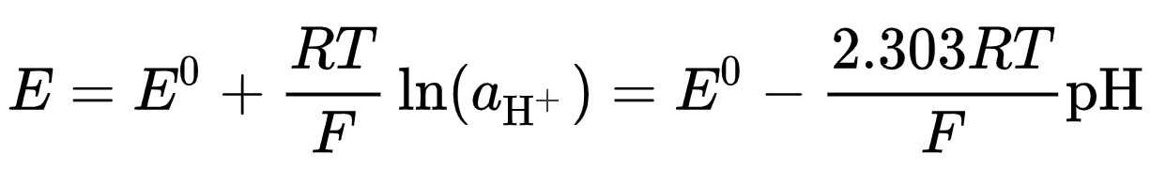
Ion-selective electrodes,
This definition of pH was adopted because ion-selective electrodes:
which are used to measure pH, respond to activity.
Ideally, electrode potential, E, follows the Nernst equation, which, for the hydrogen ion can be written as
where E is a measured potential, E⁰ is the standard electrode potential, R is the gas constant, T is the temperature in kelvins, F is the Faraday constant.

Slide 21
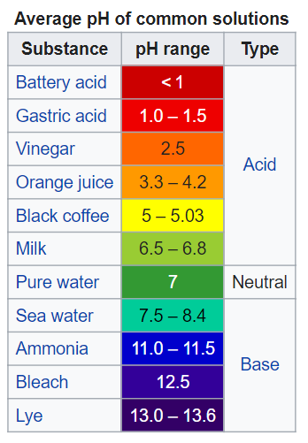
pH indicators
Indicators may be used to measure pH, by making use of the fact that their color changes with pH.
Visual comparison of the color of a test solution with a standard color chart provides a means to measure pH accurate to the nearest whole number.
More precise measurements are possible if the color is measured spectrophotometrically, using a colorimeter or spectrophotometer.
Universal indicator consists of a mixture of indicators such that there is a continuous color change from about pH 2 to pH 10. Universal indicator paper is made from absorbent paper that has been impregnated with universal indicator. Another method of measuring pH is using an electronic pH meter

Slide 22
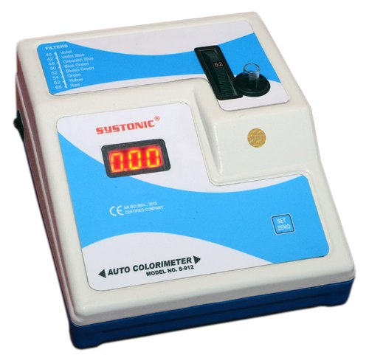
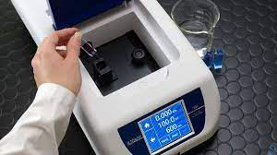
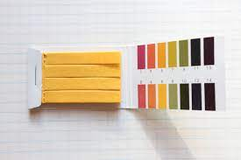
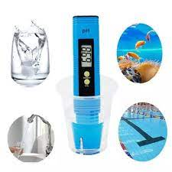
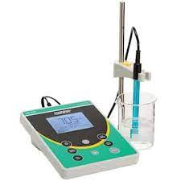
Spectrophotometer
- pH meter -
Universal Indicator

Slide 23
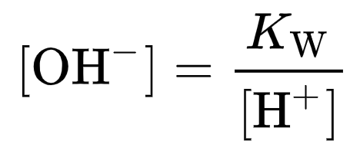
pOH
pOH is sometimes used as a measure of the concentration of hydroxide ions, OH⁻.
pOH values are derived from pH measurements. The concentration of hydroxide ions in water is related to the concentration of hydrogen ions by
where K_{W} is the self-ionization constant of water.

Slide 24
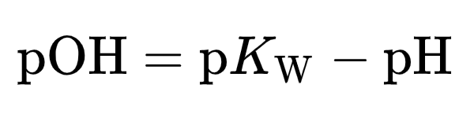
Taking logarithms
So, at room temperature, pOH ≈ 14 − pH.
However this relationship is not strictly valid in other circumstances, such as in measurements of soil alkalinity.

Slide 25
Neutrality
Neutrality is defined as the condition where [H⁺] = [OH⁻] (or the activities are equal)

Slide 26
Since self-ionization of water holds,
the product of these concentration [H⁺]×[OH⁻] = K_{w}, it can be seen that at neutrality
Therefore, [H⁺] = [OH⁻] = √K_{w}, or
pH = pK_{w}/2. pK_{w} is approximately 14
but depends on ionic strength and temperature, and so the pH of neutrality does also

Slide 27
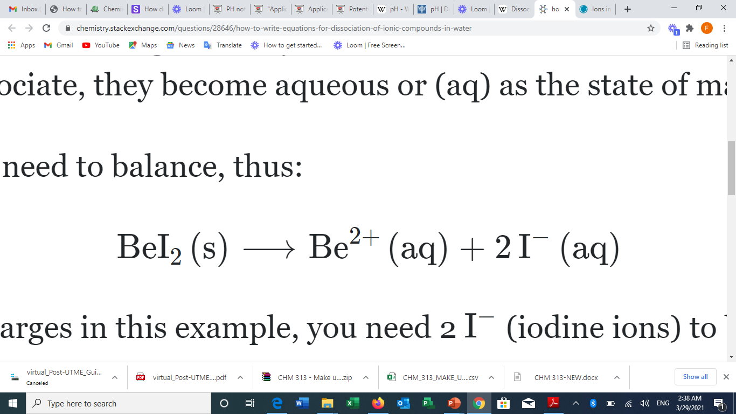
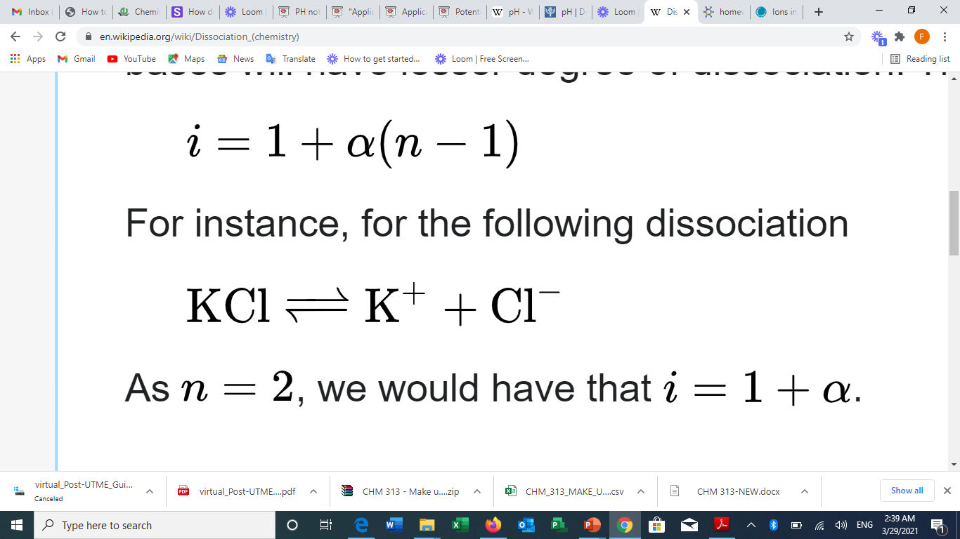
Dissociation of Ionic Solids (& Compounds)
Dissociation in chemistry is a general process in which molecules (or ionic compounds such as salts, or complexes) separate or split into smaller particles such as atoms, ions, or radicals, usually in a reversible manner.

Slide 28
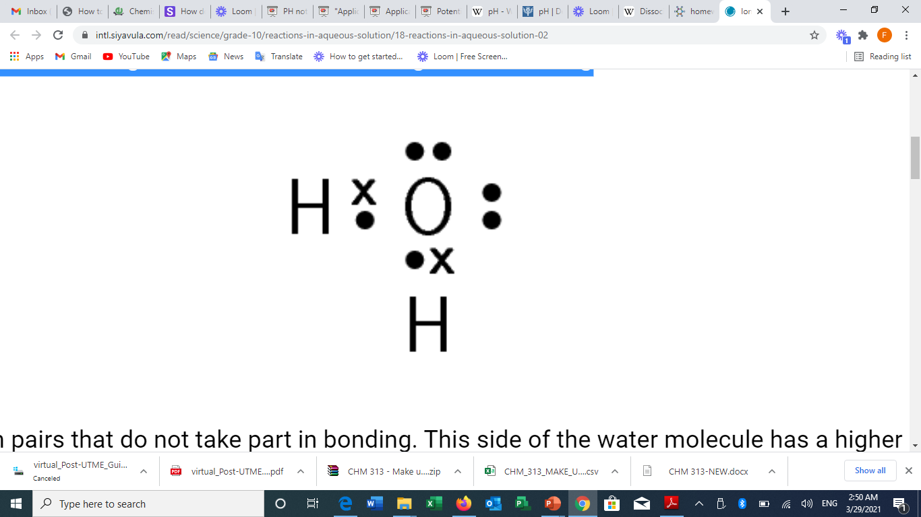
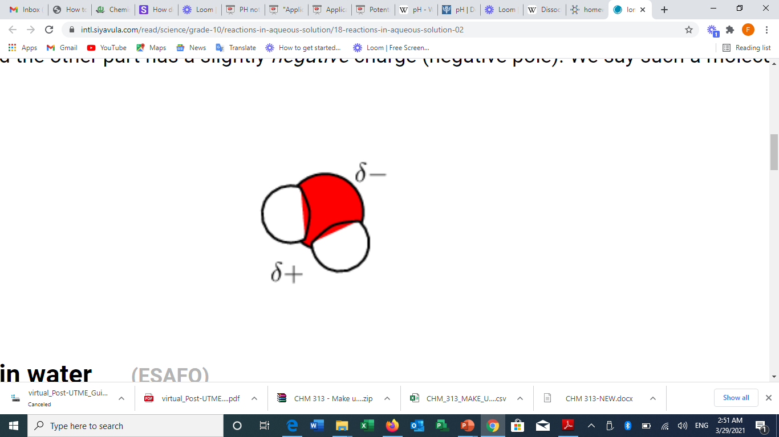
Dissociation in water
Water is a polar molecule. If we represent water using Lewis structures we will get the following

Slide 29
Dissociation of sodium chloride in water
It is the polar nature of water that allows ionic compounds to dissolve in it.
In the case of sodium chloride (NaCl) for example, the positive sodium ions (Na⁺) are attracted to the negative pole of the water molecule, while the negative chloride ions (Cl⁻) are attracted to the positive pole of the water molecule.
When sodium chloride is dissolved in water, the polar water molecules are able to work their way in between the individual ions in the lattice.
The water molecules surround the negative chloride ions and positive sodium ions and pull them away into the solution.
This process is called dissociation

Slide 30
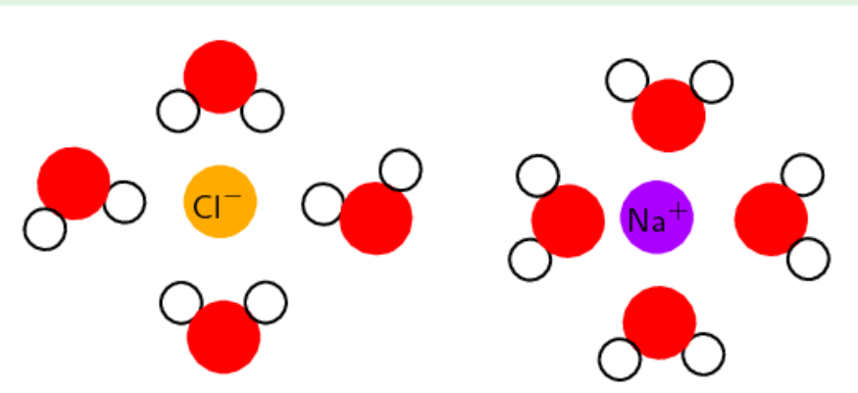
Sodium chloride dissolves in water

Slide 31
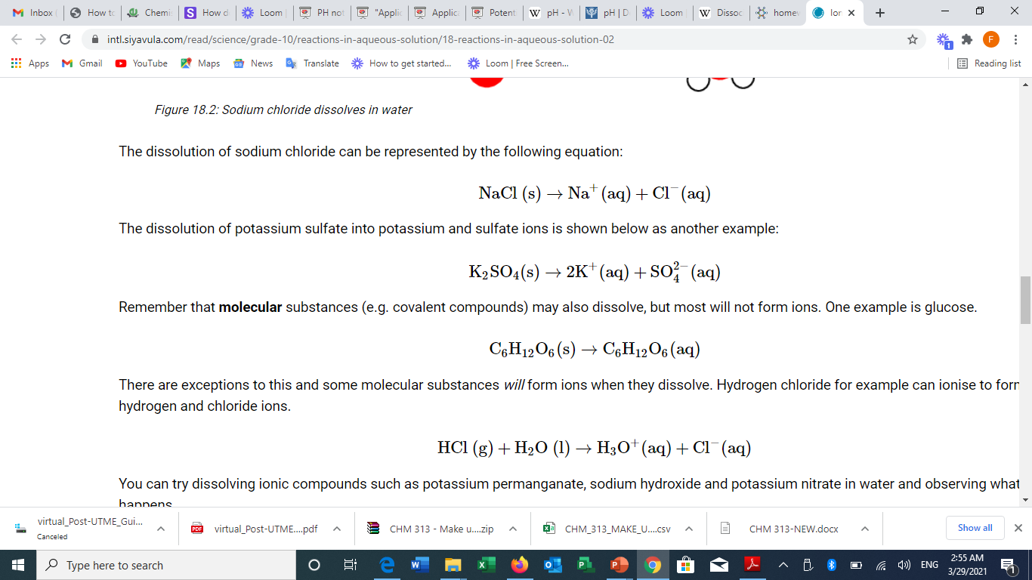
form

Slide 32
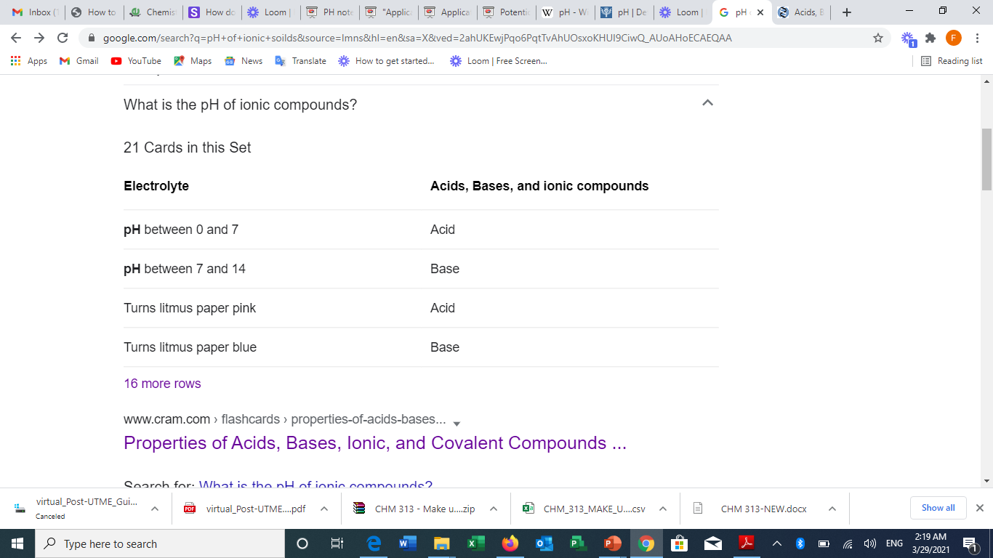
For Acids , Bases & Ionic Solids

Slide 33
Calculating pH for Acids , Bases & Ionic Solids
[pH] or potential of Hydrogen, is measured on a scale from 0 to 14. 0 being the most ACIDIC, while 14 being the most BASIC
To find pH from the concentration of H₃O⁺ (or just simply H⁺) you need to do the following:
pH= -log[H₃O⁺] or -log[H⁺]
The [H₃O⁺] or [H⁺] is just the concentration (in molarity)
If you have the concentration of OH⁻, however, simply find the pOH by:
pOH=-log[OH−]
After you get this number, you do the following:
pH= 14-pOH

Slide 34

Related questions

Slide 35


Slide 36


Slide 37


Slide 38
The importance of water pH is to keep your body in balance and to regulate metabolic processes. A diet high in acidity will lead to weight gain, slower immune response, and susceptibility to disease, while a diet too alkaline will lead to inability to metabolize key nutrients.

Slide 39


Slide 40


Slide 41
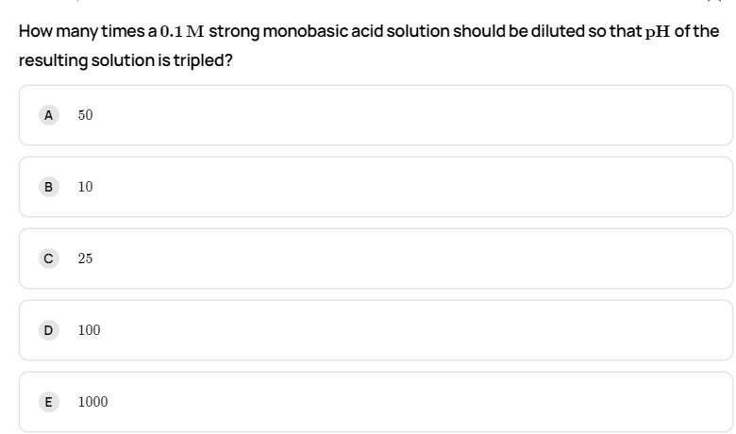

Slide 42
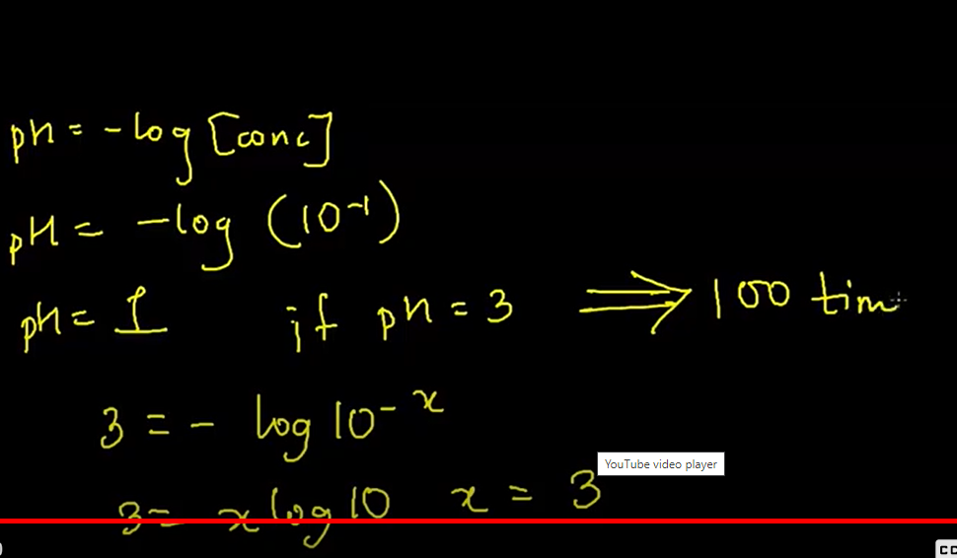

Slide 43

OR

Slide 44


Slide 45


Slide 46


Slide 47
Answer
Correct option is C
1 M H2​SO4​ solution
Given concentration of all the acidic solutions is equal. However, H2​SO4​ being the strongest acid will dissociate completely thus giving highest concentration of H+ ions.

Slide 48


Slide 49
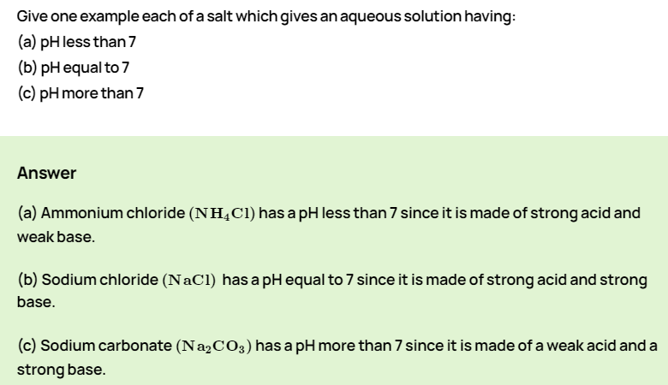

Slide 50


Slide 51
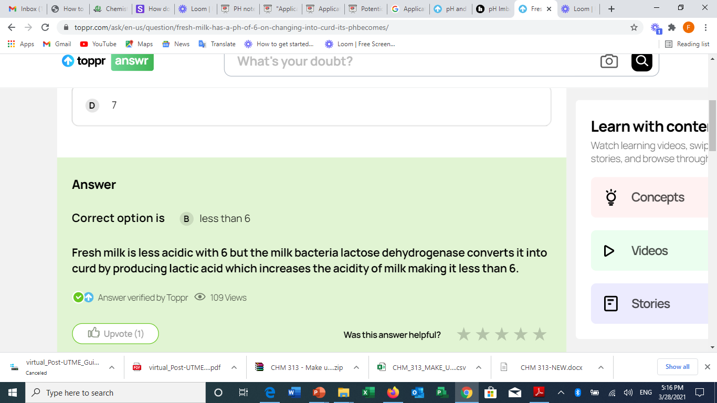

Slide 52
pH balance disorders
A blood pH imbalance can lead to two conditions: acidosis and alkalosis.
Acidosis refers to having blood that’s too acidic, or a blood pH of less than 7.35. Alkalosis refers to having blood that’s too basic, or a blood pH of higher than 7.45.
There are different types of acidosis and alkalosis based on the underlying cause.
When acidosis or alkalosis is caused by a lung disorder or issue with exhalation, it’s referred to as “respiratory.” When acidosis or alkalosis is caused by a problem with the functioning of the kidneys, it’s referred to as “metabolic.”

Slide 53
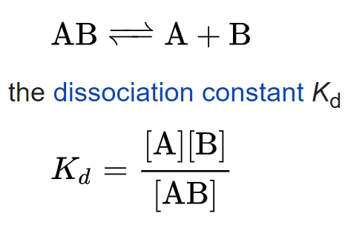

Slide 54
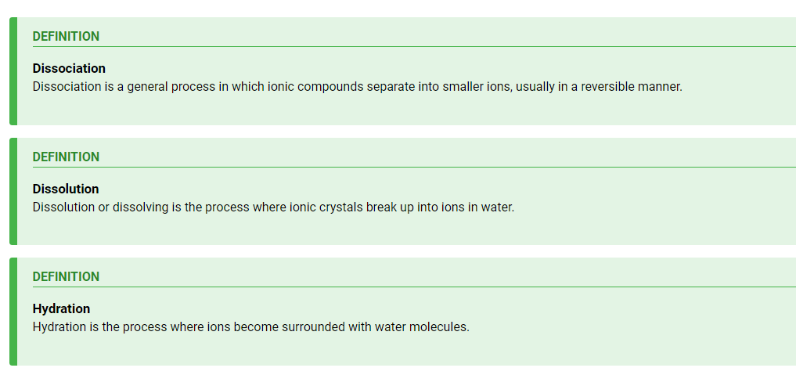
Similar Concepts in dissociation

Slide 55
Recap -------Revision

Slide 56
Table of Common Ions
Common Positive Ions (Cations)
Monovalent |  | Divalent |  | Trivalent
Hydronium (aqueous) | H₃O⁺ | magnesium | Mg²⁺ | aluminium | Al³⁺
Hydrogen (proton) | H⁺ | calcium | Ca²⁺ | Antimony III | Sb³⁺
lithium | Li⁺ | strontium | Sr²⁺ | Bismuth III | Bi³⁺
Sodium | Na⁺ | Beryllium | Be²⁺
Potassium | K⁺ | manganese II | Mn²⁺
Rubidium | Rb⁺ | barium | Ba²⁺
Cesium | Cs⁺ | zinc | Zn²⁺
Francium | Fr⁺ | Cadmium | Cd²⁺
Silver | Ag⁺ | Nickel II | Ni²⁺
Ammonium | NH₄⁺ | Palladium II | Pd²⁺
Thalium | Tl⁺ | Platinum II | Pt²⁺
copper I | Cu⁺ | copper II | Cu²⁺
 |  | Mercury II | Hg²⁺
 |  | mercury I | Hg₂²⁺
 |  | iron II | Fe²⁺ | iron III | Fe³⁺
 |  | Cobalt II | Co²⁺ | Cobalt III | Co³⁺
 |  | chromium II | Cr²⁺ | chromium III | Cr³⁺
 |  | lead II | Pb²⁺
 |  | tin II | Sn²⁺

Slide 57
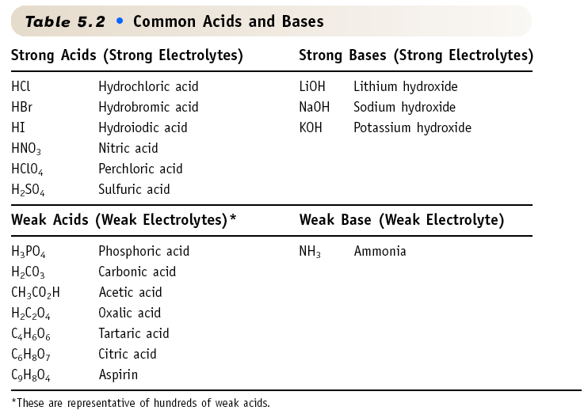
You should know the strong acids & bases

Slide 58
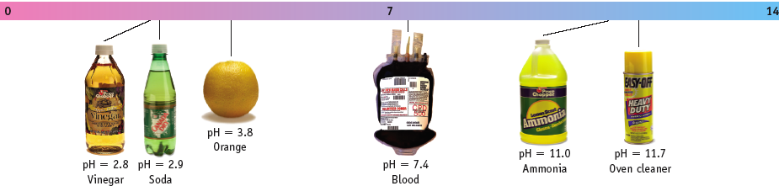
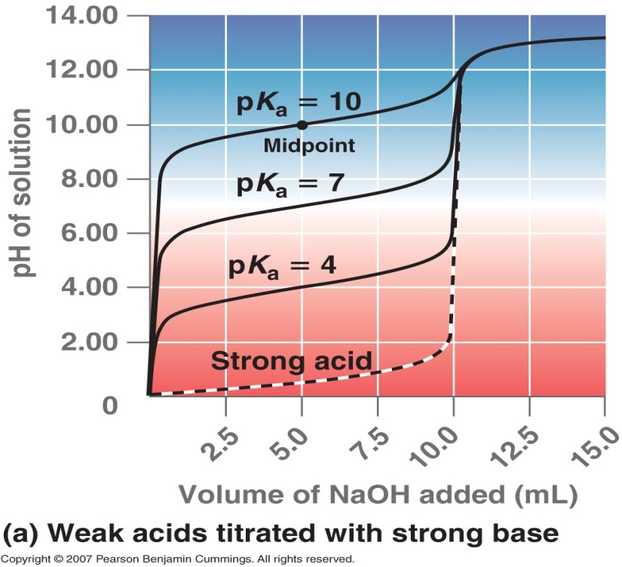
pH, a Concentration Scale
pH: a way to express acidity -- the concentration of H⁺ in solution.
Low pH: high [H⁺]
High pH: low [H⁺]
Acidic solution pH < 7
Neutral pH = 7
Basic solution pH > 7
pH = log (1/ [H⁺]) = - log [H⁺]
Acid | Formula | pH at half equivalence point
Acetic | CH₃COOH | 4.7
Nitrous | HNO₂ | 3.3
Hydrofluoric | HF | 3.1
Hypochlorous | HClO | 7.4
Hydrocyanic | HCN | 9

Slide 59
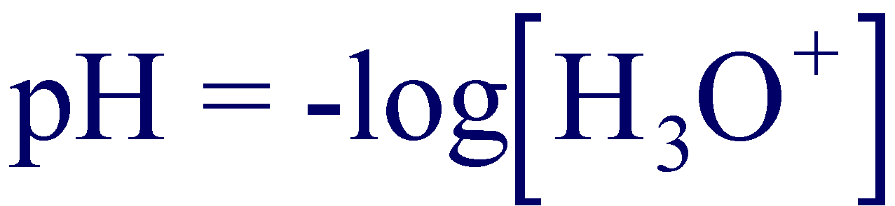
pH, a Concentration Scale
A convenient way to express the acidity and basicity of a solution is the pH and pOH scales.
The pH of an aqueous solution is defined as:
Acid | Formula | pH
Acetic | CH₃COOH | 4.7
Nitrous | HNO₂ | 3.3
Hydrofluoric | HF | 3.1
Hypochlorous | HClO | 7.4
Hydrocyanic | HCN | 9

Slide 60
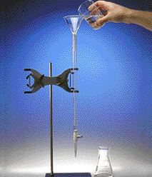
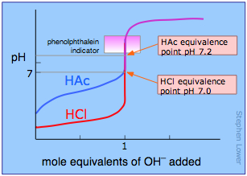
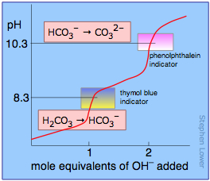
Titration
1. Add solution from the buret.
2. Reagent (base) reacts with compound (acid) in solution in the flask.
3. Indicator shows when exact stoichiometric reaction has occurred.
4. Net ionic equation
H⁺ + OH⁻ --> H₂O
5. At equivalence point
moles H⁺ = moles OH⁻
Titrant
Equivalence Point
Primary Standard
End Point
Secondary Standard
Titration

Slide 61
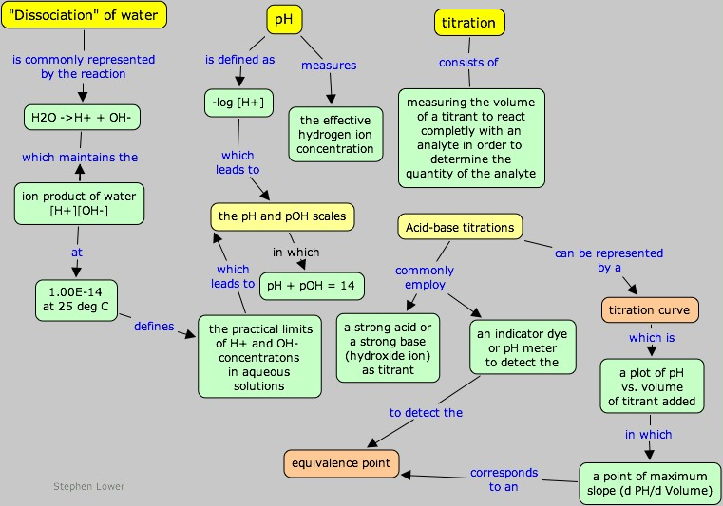
http://www.chem1.com/acad/webtext/abcon/abcon-2.html

Slide 62
Autoionization of Water
Because water is amphiprotic, one water molecule can react with another to form an OH– ion and an H₃O⁺ ion in an autoionization process:
2H₂O_{(l)}⇋H₃O⁺ _{(aq)} + OH– _{(aq)}
• Equilibrium constant K for this reaction can be written as
[H₃O⁺] [OH–]
[H₂O]²
When pure liquid water is in equilibrium with hydronium and hydroxide ions at 25ºC, the concentrations of hydronium ion and hydroxide ion are equal:
[H₃O⁺]=[OH–] = 1.0 x 10^{–7} M [H₃O⁺][OH–] = 1.0 x 10^{–14} M = K_{w}
pH = pOH = 7 pH + pOH = pK_{w} = 14
K_{c} =
K_{c} [H₂O]² = K_{w} = [H₃O⁺][OH–] = 1.0 x 10^{–14}

Slide 63
New Topic

Slide 64
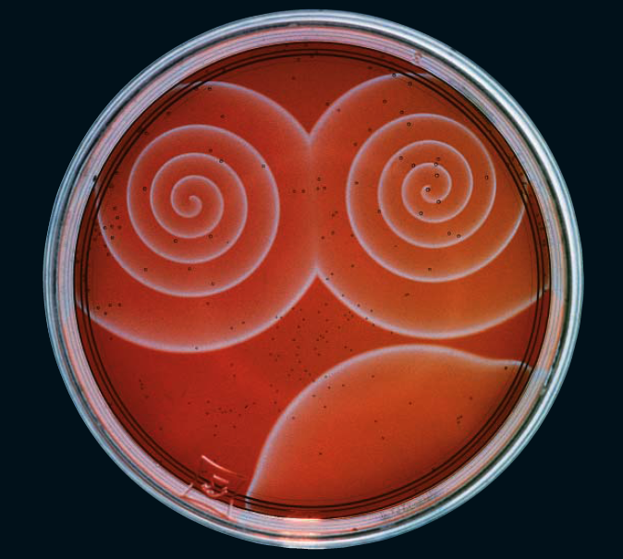

Solubility and Complexation Equilibria

Slide 65
CHAPTER OBJECTIVES
To be able to calculate the solubility of an ionic compound from its K_{sp}
To understand the factors that determine the solubility of ionic compounds
To be able to describe complex-ion formation quantitatively
To understand why the solubility of many compounds depends on pH

Slide 66
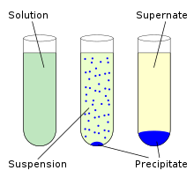
What is Solubility
Solubility is the property of a solid, liquid or gaseous chemical substance called solute to dissolve in a solid, liquid or gaseous solvent.
The solubility of a substance fundamentally depends on the physical and chemical properties of the solute and solvent as well as on temperature, pressure and presence of other chemicals (including changes to the pH) of the solution

Slide 67
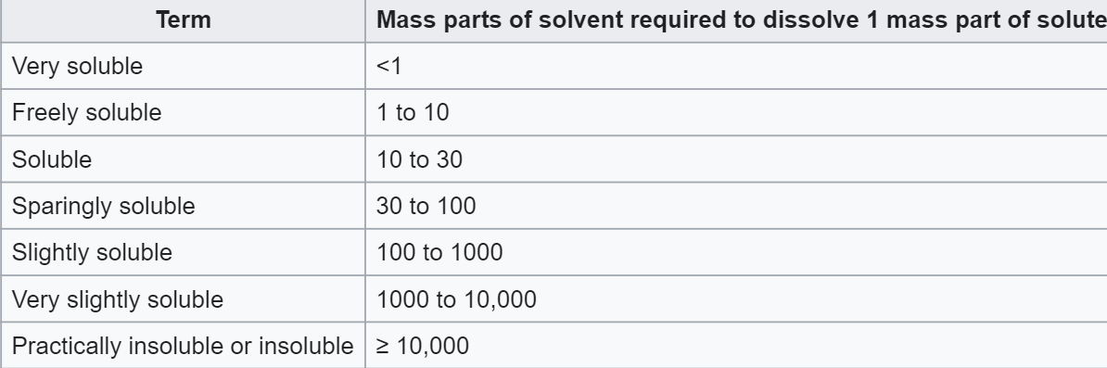
Solubility may be stated in various units of concentration such as molarity, molality, mole fraction, mole ratio, mass (solute) per volume (solvent) and other units.
A number of other descriptive terms are also used to qualify the extent of solubility for a given application. For example, U.S. Pharmacopoeia gives the following terms:

Slide 68
Determining the Solubility of Ionic Compounds

Slide 69
Definition of TERMS: The Solubility Product, K_{sp}
When a slightly soluble ionic compound is added to water, some of it dissolves to form a solution, establishing an equilibrium between the pure solid and a solution of its ions.
The equilibrium constant for the dissolution of a sparingly soluble salt is the solubility product of the salt, K_{sp}.
The concentration of a pure solid is a constant and does not appear in the equilibrium constant expression.
Solubility products are determined experimentally by either directly measuring the concentration of one of the component ions or by measuring the solubility of the compound in a given amount of water.
K_{sp} is defined in terms of molar concentrations of the component ions.

Slide 70
Definition of TERMS: The Ion Product
The ion product (Q) of a salt is the product of the concentrations of the ions in solution raised to the same powers as in the solubility product expression.
The ion product describes concentrations that are not necessarily equilibrium concentrations, whereas K_{sp} describes equilibrium concentrations.
The process of calculating the value of the ion product and comparing it with the magnitude of the solubility product is a way to determine if a solution is unsaturated, saturated, or supersaturated and whether a precipitate will form when solutions of two soluble salts are mixed.

Slide 71
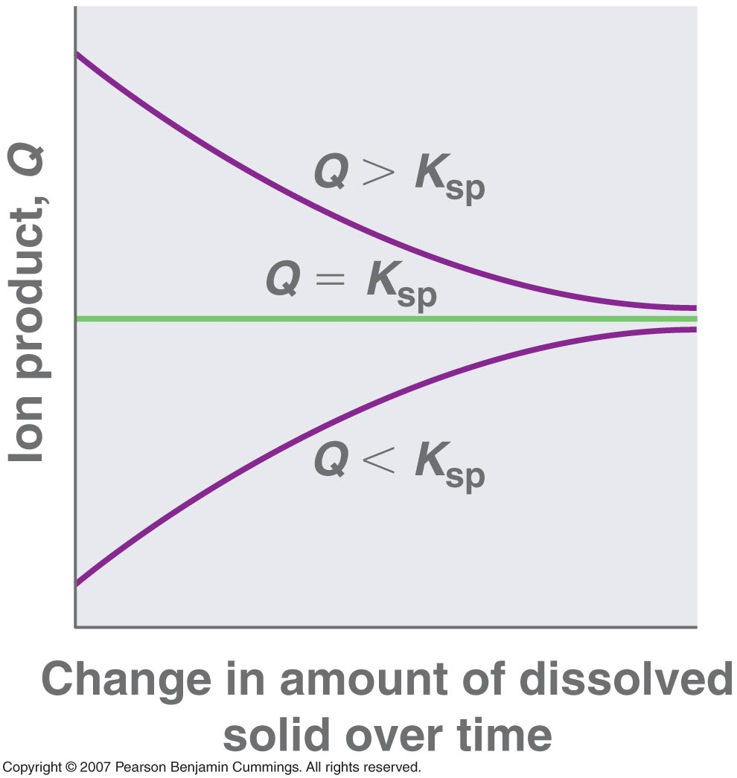
Definition of TERMS: The Ion Product
Three possible conditions for an aqueous solution of an ionic solid
1. Q < K_{sp}: the solution is unsaturated, and more of the ionic solid will dissolve
2. Q = K_{sp}: the solution is saturated and at equilibrium
3. Q > K_{sp}: the solution is supersaturated, and ionic solid will precipitate

Slide 72
Definition of TERMS: The Common Ion Effect and Solubility
• Solubility product expression
– Equilibrium concentrations of cation and anion are inversely related
– As the concentration of the anion increases, the maximum concentration of the cation needed for precipitation to occur decreases, and vice versa
– K_{sp} is constant

Slide 73
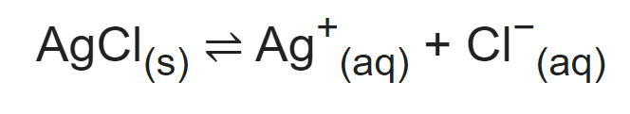
Solubility of ionic compounds in water
Some ionic compounds (salts) dissolve in water, which arises because of the attraction between positive and negative charges.
For example, the salt's positive ions (e.g. Ag⁺) attract the partially negative oxygens in H₂O. Likewise, the salt's negative ions (e.g. Cl⁻) attract the partially positive hydrogens in H₂O.
Note: oxygen is partially negative because it is more electronegative than hydrogen, and vice versa

Slide 74
Solubility product, K_{sp}.
However, there is a limit to how much salt can be dissolved in a given volume of water.
This amount is given by the solubility product, K_{sp}.
This value depends on the type of salt (AgCl vs. NaCl, for example), temperature, and the common ion effect.

Slide 75
Calculation of Solubility
One can calculate the amount of AgCl that will dissolve in 1 liter of water.
Some algebra is required:
K_{sp} = [Ag⁺] × [Cl⁻]
(definition of solubility product)
Ksp = 1.8 × 10−10 (from a table of solubility products)
[Ag⁺] and [Cl⁻] are conc of Silver and Chloride ions respectively

Slide 76
Interpretation
Ag+] = [Cl−], in the absence of other silver or chloride salts,
[Ag⁺]2 = 1.8 × 10⁻¹⁰
[Ag⁺] = 1.34 × 10⁻⁵
Meaning of the result: 1 liter of water can dissolve 1.34 × 10⁻⁵ moles of AgCl(s) at room temperature.
Compared with other types of salts, AgCl is poorly soluble in water. In contrast, table salt (NaCl) has a higher Ksp and is, therefore, more soluble.

Slide 77
Factors That Affect Solubility

Slide 78
Factors That Affect Solubility
• The solubility product of an ionic compound describes the concentrations of ions in equilibrium with a solid.
• There are four reasons that the solubility of a compound may be other than expected:
1. Ion-pair formation
2. Incomplete dissociation of molecular solutes
3. Formation of complex ions
4. Changes in pH
(O level concepts…: Temperature, Pressure, Polarity and rate of dissolution)

Slide 79
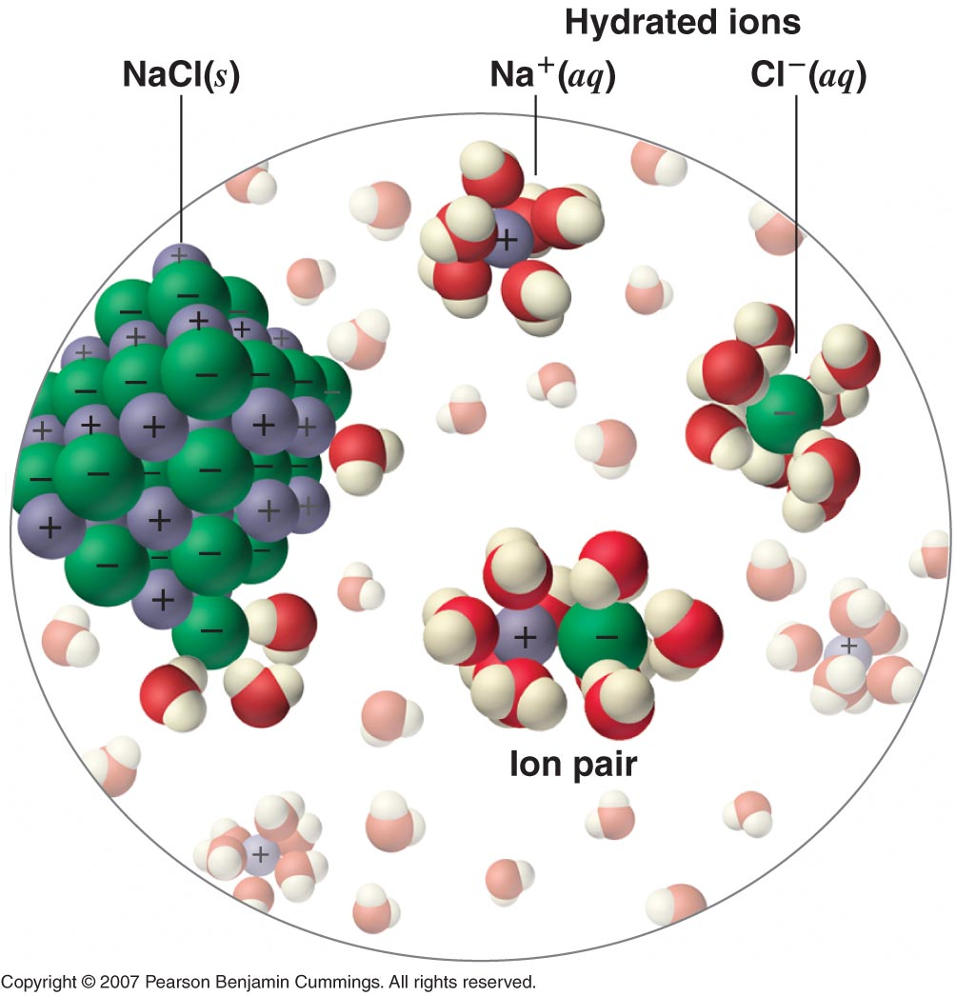
Ion-Pair Formation
• An ion pair consists of a cation and anion that are in intimate contact in solution, rather than separated by solvent.

Slide 80
Ion-Pair Formation
• Ions in an ion pair are held together by the same attractive electrostatic forces as for ionic solids.
– Ions in an ion pair migrate as a single unit, whose net charge is the sum of the charges on the ions.
– The ion pair is a species intermediate between the ionic solid (in which each ion participates in many cation-anion interactions that hold the ions in a rigid array) and the completely dissociated ions in solution (where each is fully surrounded by water molecules and free to migrate independently).

Slide 81
Ion-Pair Formation
• Ion pairs
– A second equilibrium must be included to describe the solubility of salts that form ion pairs.
– An ion pair is represented by the symbols of the individual ions separated by a dot, to indicate that they are associated in solution (Ca²⁺ ·SO₄^{2–}).
– The formation of an ion pair is a dynamic process, so a particular ion pair may exist only briefly before dissociating into the free ions, each of which may later associate briefly with other ions.
– Ion-pair formation has a major effect on the measured solubility of a salt and is most important for salts that contain M²⁺ and M³⁺ ions; it is unimportant for salts that contain monocations.

Slide 82
Incomplete Dissociation
• A molecular solute may be more soluble than predicted by the measured concentrations of ions in solution due to incomplete dissociation.
– Common for weak organic acids
– Weak acids do not dissociate completely into their constituent ions (H⁺ and A–) in water
– The molecular (undissociated) form of a weak acid (HA) is quite soluble in water
– Many carboxylic acids have a limited solubility in water

Slide 83
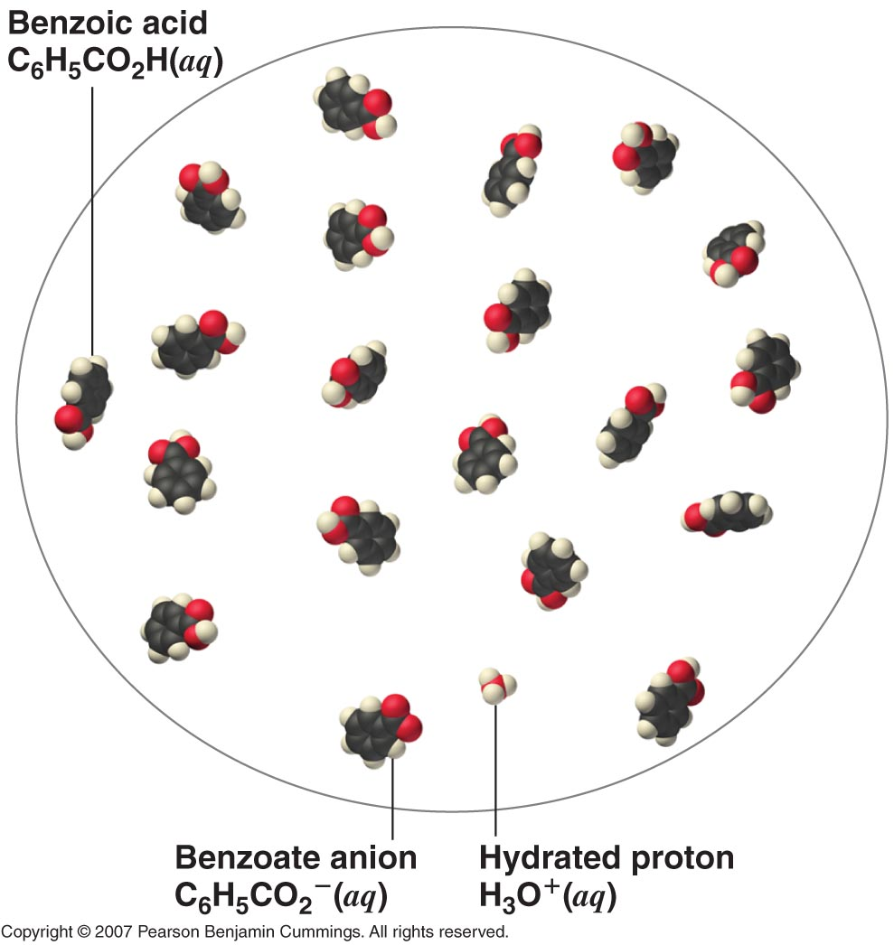
Incomplete Dissociation

Slide 84
Complex-Ion Formation

Slide 85
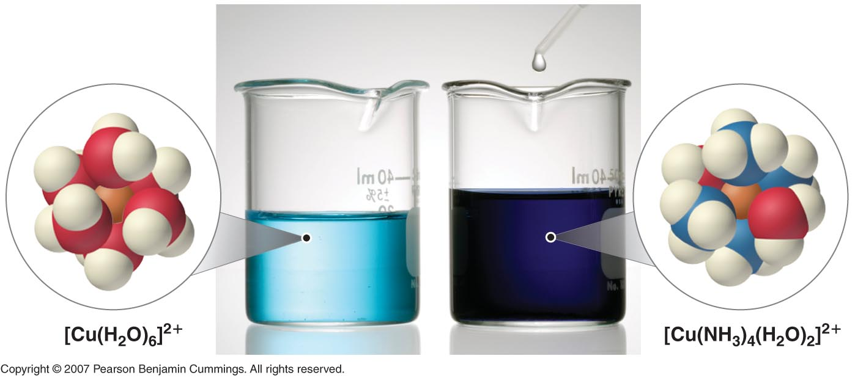
Complex-Ion Formation
Metal ions in aqueous solution are hydrated—surrounded by a shell of four to six water molecules.
A hydrated ion is one kind of complex ion, molecules or ions that contain at least one lone pair of electrons. , a species formed between a central metal ion and one or more surrounding ligands (Note the definition)
A complex ion forms from a metal ion and a ligand because of a Lewis acid-base interaction.
– The positively charged metal ion acts as a Lewis acid, and the ligand, with one or more lone pairs of electrons, acts as a Lewis base.
– Small, highly charged metal ions have the greatest tendency to act as Lewis acids and to form complex ions.

Slide 86
The Formation Constant
The equilibrium constant for the formation of the complex ion from the hydrated ion is called the formation constant (K_{f}).
Equilibrium constant expression for K_{f} has the same general form as any other equilibrium constant expression.
The larger the value of K_{f}, the more stable the product.

Slide 87
The Effect of Complex-Ion Formation on Solubility
The solubility of a sparingly soluble salt increases if a ligand that forms a stable complex ion is added to the solution.
The formation of a complex ion by the addition of a complexing agent increases the solubility of a compound.
Complexing agents are molecules or ions that increase the solubility of metal salts by forming soluble metal complexes. (Note the definition)
Other examples of complexing agents are: EDTA, Ammonia, phosphates, phosphonates, polycarboxylates, and zeolites

Slide 88
Solubility and pH

Slide 89
Solubility and pH
Solubility of many compounds depend strongly on the pH of the solution
– The anion in many sparingly soluble salts is the conjugate base of a weak acid that may become protonated in solution.
– The solubility of simple binary compounds such as oxides and sulfides are dependent on pH.

Slide 90
The Effect of Acid-Base Equilibria on the Solubility of Salts
• Examining the effect of pH on the solubility of a representative salt, M⁺A–, where A– is the conjugate base of the weak acid HA
– When the salt dissolves in water, this reaction occurs:
M A_{(s)} ⇋ M⁺_{(aq)} + A–_{(aq)} K_{sp} = [M⁺] [A–]
– The anion can also react with water in a hydrolysis reaction:
A–_{(aq)} + H₂O_{(l)}⇋OH–_{(aq)} + HA_{(aq)}
– If a strong acid is added to the solution, the added H⁺ will react essentially completely with A– to form HA, which decreases [A–] and which in turn decreases the magnitude of the ion product, Q = [M⁺] [A–]
– More MA will dissolve until Q = K_{sp}

Slide 91
Solubility and Partition Phenomena

Slide 92
Contents
Solubility
Definitions
Factors influencing solubility
The effect of pH on solubility
The effect of pressure
Influence of solvents on solubility

Slide 93
Contents
Partition Phenomena
Partition concepts
For weak electrolytes as solutes
Drug absorption
pH partition hypothesis
Site of drug partitioning

Slide 94
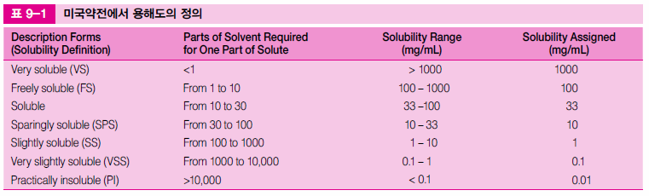
Definitions
Solubility is the concentration of a solute when the solvent has dissolved all the solute that it can at a given temperature
Martin’s Physical Pharmacy & Pharmaceutical Sciences 6th edition
Patrick J. Sinko

Slide 95
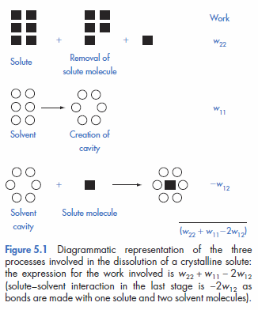
Factors influencing solubility
Dissolution of a crystal
1. A solute (drug) molecule is removed from its crystal
2. A cavity for the molecule is created in the solvent
3. The solute molecule is inserted into this cavity
* Physicochemical Principles of Pharmacy 4th edition
Alexander T Florence and David Attwood

Slide 96
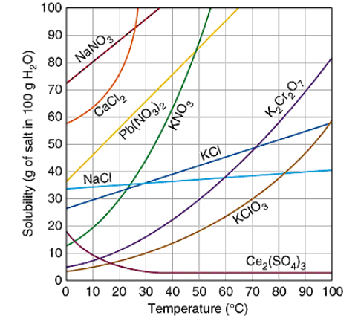
Factors influencing solubility
Temperature & Pressure
Solubility is an equilibrium value that is dependent on a given temperature and pressure
Solubility does not depend on how fast a substance dissolves in the solvent

Slide 97
Factors influencing solubility
Temperature
Heat of solution (ΔH_{soln})
The enthalpy change associated with the dissolution of a substance in a solvent
*
Table. Heat of solution
Solute | ΔH_{soln} (25℃) kcal/mole
HCl | - 17.96
NaOH | - 10.6
CH₃COOH | - 0.36
NaCl | + 1.0
KMnO₄ | + 10.4
Mannitol | + 5.26
KI | + 4.3

Slide 98
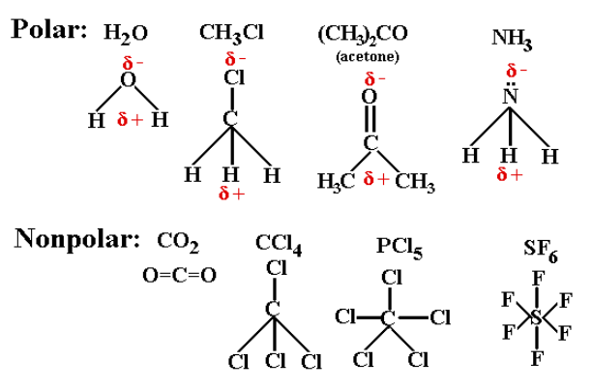
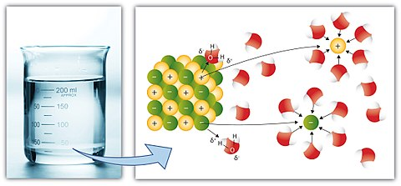
Factors influencing solubility
Chemical structure
Dipole moment
A measure of polarity
Molecules that have a high dipole moment are more soluble in polar solvents such as water

Slide 99
Factors influencing solubility
Chemical structure
Dielectric properties
Related to the ability to store charge
How a substance interacts with solvents
*
Table 6-5 Dielectric Constants of Some Solvents at 25℃
Solvent | Dieletric constant
Water | 78.5
Glycerin | 40.1
Propylene glycol | 32.01
Methanol | 31.5
Acetone | 19.1
PEG 400 | 12.5
Cottonseed oil | 6.4
Ether | 4.3
* Applied Physical Pharmacy
Mansoor M.Amiji, Beverly J.Sandmann

Slide 100
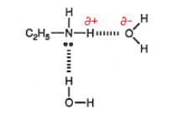
Factors influencing solubility
Chemical structure
Hydrogen bonding
The attractive interaction of a hydrogen atom with an electronegative atom, such as nitrogen, oxygen or fluorine
Major factor on solubility in water
Amines with small alkyl groups are very soluble in water. This is because hydrogen bonding occurs between the amine and water molecules

Slide 101
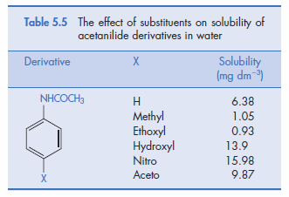
Factors influencing solubility
Chemical structure
Hydrogen bonding
The attractive interaction of a hydrogen atom with an electronegative atom, such as nitrogen, oxygen or fluorine
Major factor on solubility in water
*
The presence of hydroxyl groups or nitro groups can markedly increase the solubility.
* Physicochemical Principles of Pharmacy 4th edition
Alexander T Florence and David Attwood

Slide 102


Factors influencing solubility
A high melting point means low water solubility
cis (z) Isomer is more soluble than trans (e) isomer
*
* Physicochemical Principles of Pharmacy 4th edition
Alexander T Florence and David Attwood
# Kirk-Othmer Encyclopedia of Chemical Technology
18 OCT 2001

Slide 103
The effect of pH on solubility
Acidic drugs (HA)
Total saturation solubility of drug S, the solubility of the undissociated species HA S₀
S = S₀ + (concentration of ionised species)
By changing the pH of the solution, you can change the charge state of the solute. If the pH of the solution is such that a particular molecule carries no net electric charge, the solute often has minimal solubility and precipitates out of the solution.
* Physicochemical Principles of Pharmacy 4th edition
Alexander T Florence and David Attwood

Slide 104



The effect of pH on solubility
Acidic drugs (HA)
The dissociation constant K_{a}
According to previous page, [HA] = S_{0,} [A⁻] = S – S₀

Slide 105


The effect of pH on solubility
Acidic drugs (HA)
Taking logarithms,
[A⁻] = S – S_{0,} S₀ = [HA]
<Henderson-Hasselbalch Equation>

Slide 106
The effect of pH on solubility
Basic drugs (RNH₂)
Total saturation solubility of drug S, the solubility of the undissociated species RNH₂ S₀
S = S₀ + (concentration of ionised species)
The rate at which a drug goes into the solution when it is dissolved in an acidic or a basic medium is proportional to the solubility of the drug. Many drugs have different solubilities at different pHs. These pH-dependent solubility differences lead to pH- -dependent dissolution profiles.
* Physicochemical Principles of Pharmacy 4th edition
Alexander T Florence and David Attwood

Slide 107


The effect of pH on solubility
Basic drugs (RNH₂)
The dissociation constant K_{b}
According to previous page, [RNH₂] = S_{0,} [RNH₃⁺] = S – S₀

Slide 108


The effect of pH on solubility
Basic drugs (RNH₂)
Taking logarithms,
[RNH₃⁺] = S – S_{0,} S₀ = [RNH₂]
<Henderson-Hasselbalch Equation>

Slide 109
The effect of Pressure
Henry’s Law
C₂= σp
C₂= concentration of the dissolve gas (g/l)
p = partial pressure (mm of the undissolvegas)
σ= inverse of the Henry’s law constant, K
In a dilute solution at constant temperature, the concentration of dissolved gas is proportional to the partial pressure of the gas above the solution at equilibrium

Slide 110
Influence of (Co)Solvents on Solubility
Strong electrolytes
Strong acids and bases and all salts are soluble in water
The polar nature of water attracts the ions
Weak electrolytes
Weak acids and bases with high molecular weight are not soluble in water
Cosolvents such as alcohol, propylene glycol and polyethylene glycol are required for solubility

Slide 111

Influence of Solvents on Solubility
Cosolvents
Solubility enhancements caused by co-solvent addition occur because of changes in the bulk properties of the isotropic solution

Slide 112

Water Solubility of Ionic Compounds
If one ion from the “Soluble Compound” list is present in a compound, the compound is water soluble.

Slide 113
Other Applications of Solubility
Solubility is of fundamental importance in a large number of scientific disciplines and practical applications, ranging from
ore processing and nuclear reprocessing to
the use of medicines,
and the transport of pollutants.
In separation techniques

Slide 114


Application of Solubility : liquid–liquid extraction
The synthesis of benzoic acid from phenylmagnesium bromide and dry ice. Benzoic acid is more soluble in an organic solvent such as dichloromethane or diethyl ether, and when shaken with this organic solvent in a separatory funnel, will preferentially dissolve in the organic layer. The other reaction products, including the magnesium bromide, will remain in the aqueous layer, clearly showing that separation based on solubility is achieved. This process, known as liquid–liquid extraction, is an important technique in synthetic chemistry.

Slide 117
Wishing the best in CAT and examination

